Slide 1
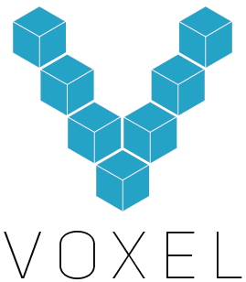

Slide 2
The Best Customizable Light Painter You Will Ever Use

Slide 3
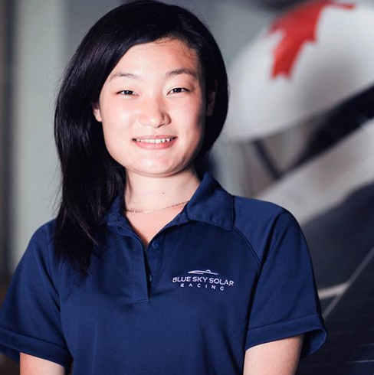
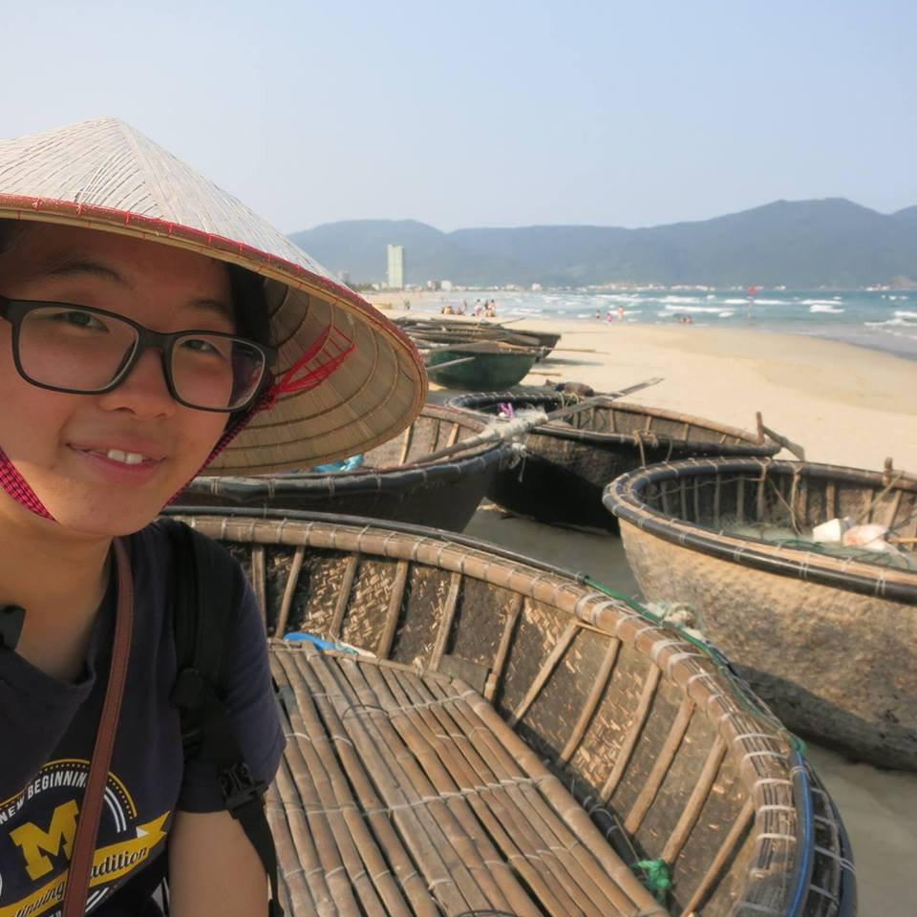
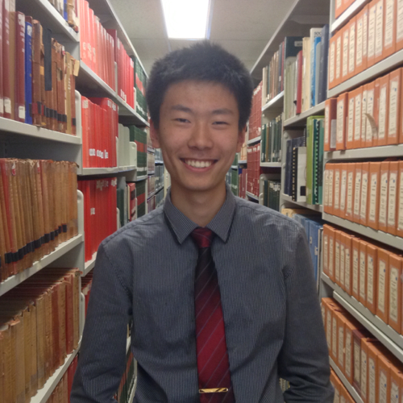
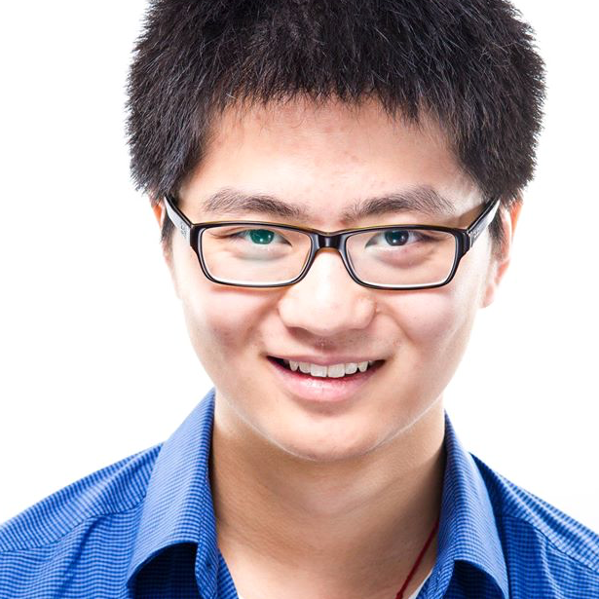
First, the new Team
Maria Xie
Lead Electrical
SciCan R&D
Blue Sky Solar EE Lead
Stephanie Kim
Lead Mechanical
Si Te Feng
Lead iOS
Pebble
Clearpath Robotics
Tiange Li
Business Development
Toronto Rehab R&D

Slide 4
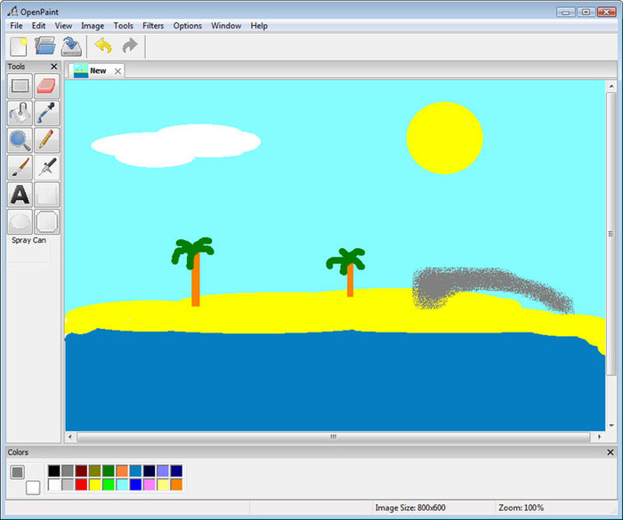
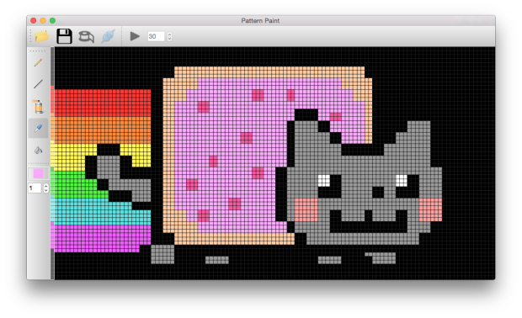
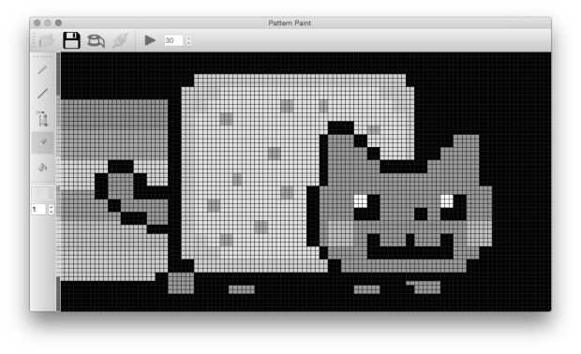
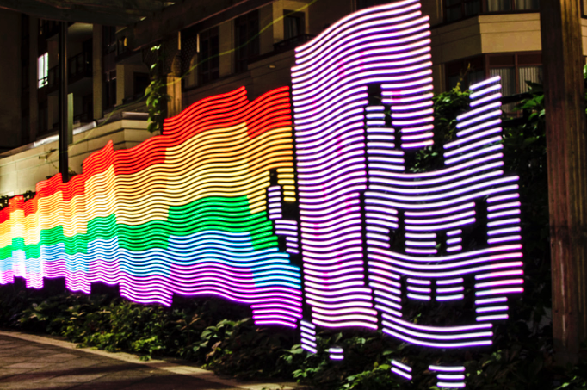
Light painting

Slide 5
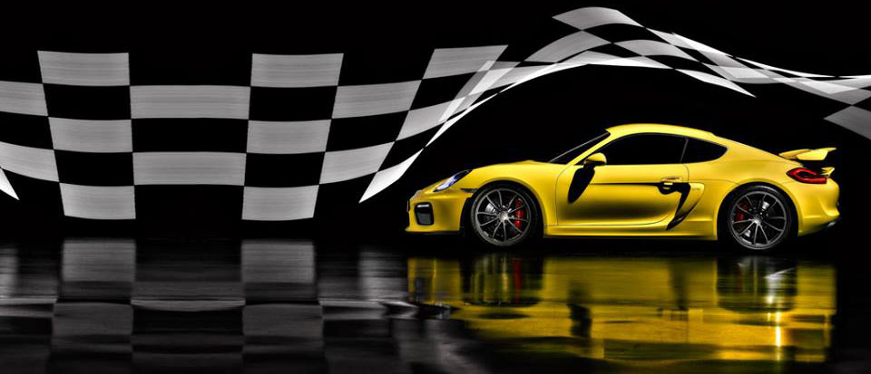
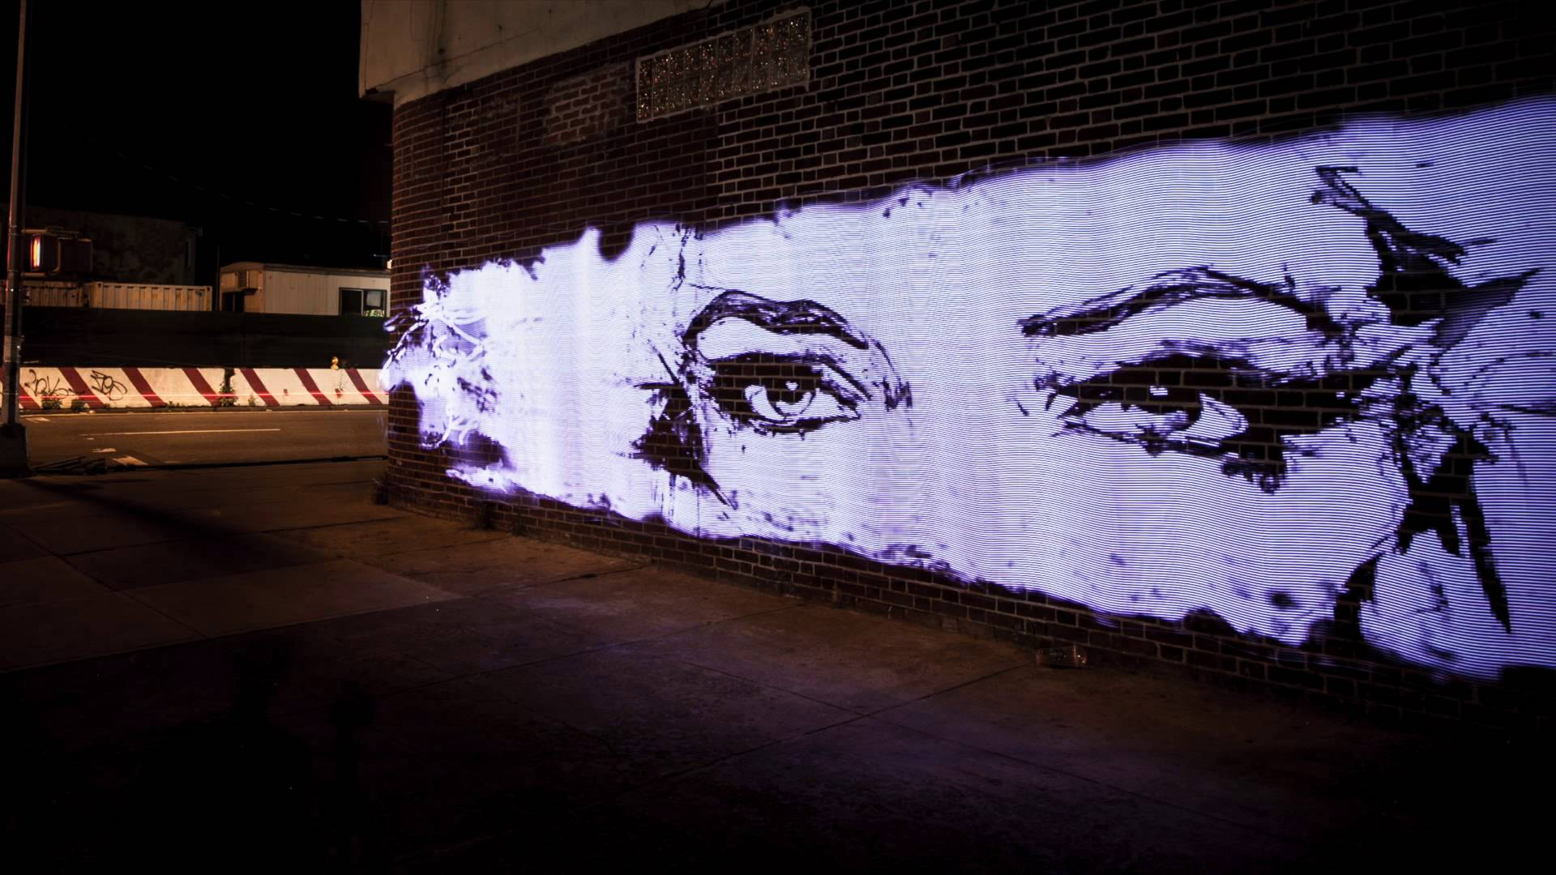
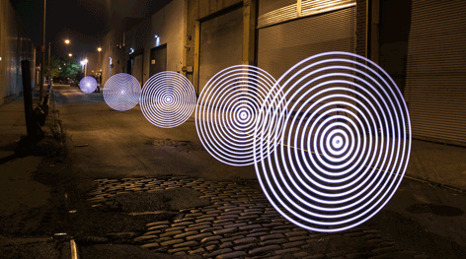
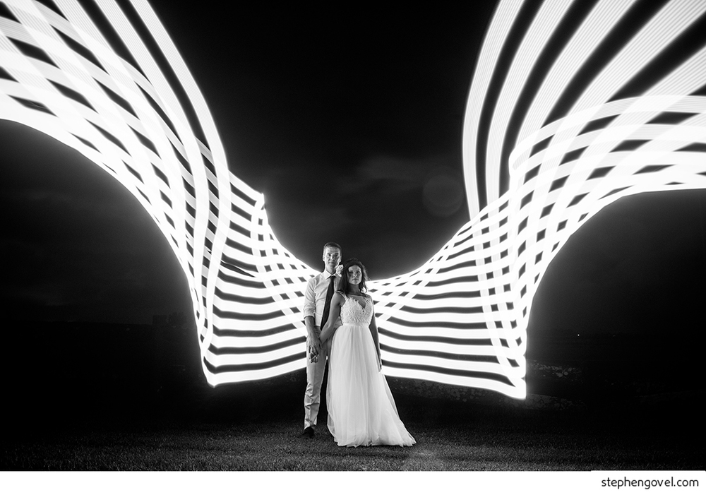
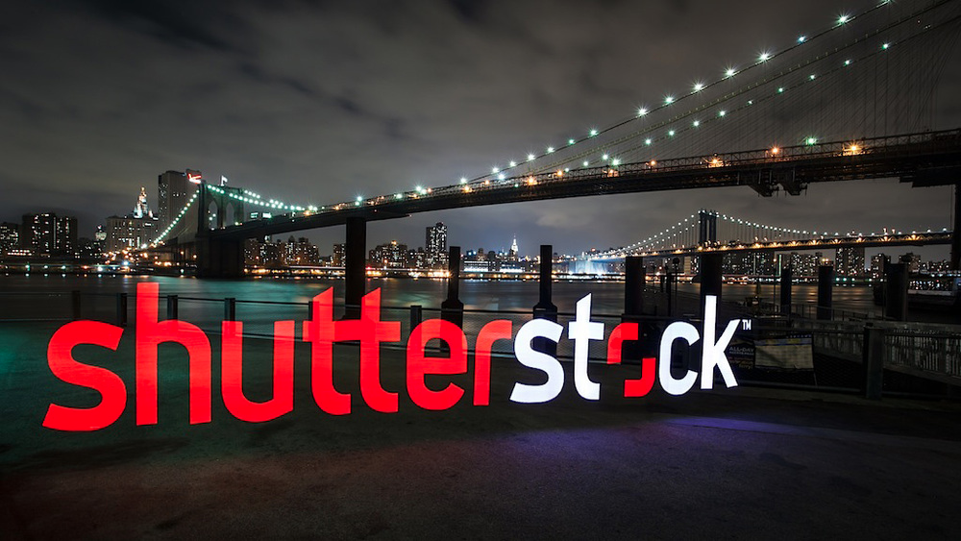
A new dimension of creativity

Slide 6
A new dimension of photography
Landscape
Architecture
Product
Weddings/events
street
Fine art
…etc.!

Slide 7
Why not photoshop?
2011 Survey (Prophoto GmbH)

Slide 8
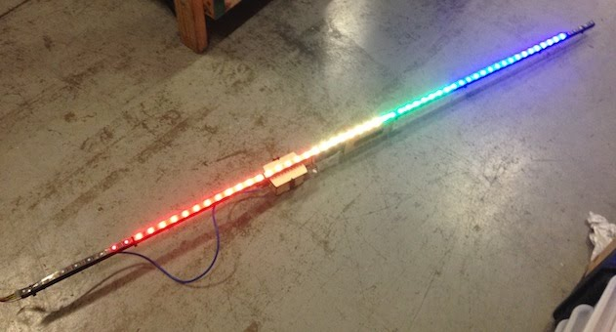
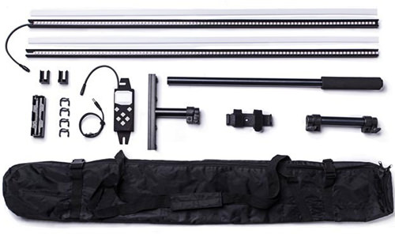
Existing tools
Diy
Pixelstick

Slide 9
terrible user experience
Repeat for every single image
Manually Convert to 24 bit BMP
Obtain Image
Manually Resize
Load onto sd card prior to shoot
Shoot pictures
Manual scrolling using file names

Slide 10
limitations
One size hardware
Limited to pre-loaded 2d images

Slide 11
We Can Do Better

Slide 12
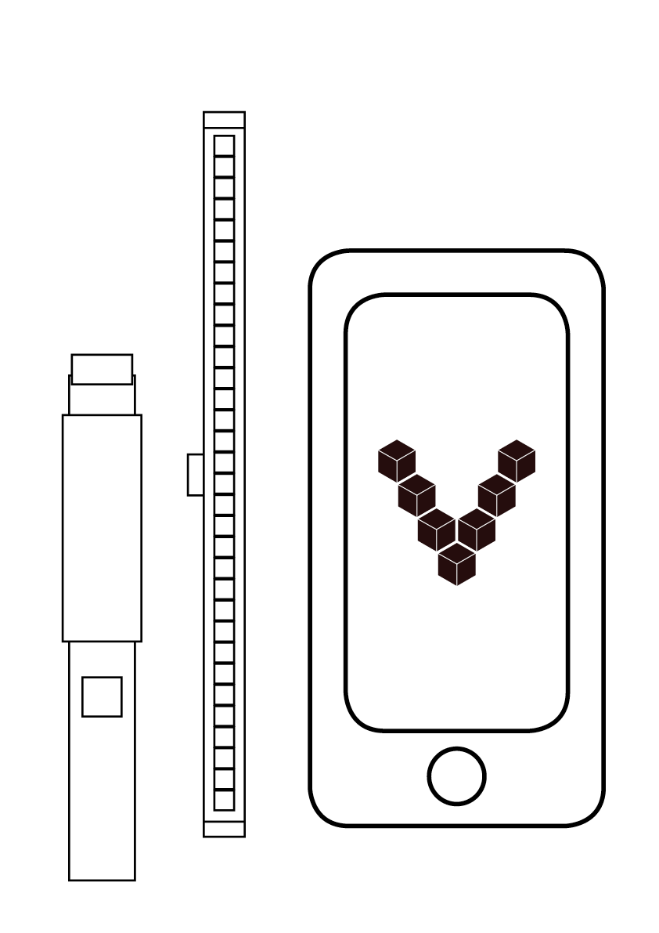
The Voxel Platform
Voxel Handle
LED modules
Mobile Freedom

Slide 13
Modular hardware

Slide 14




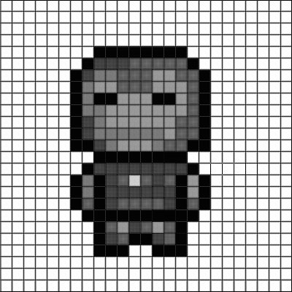
Powerful app
Paint sensor data
Wifi connectivity
Auto image processing
In app camera
In app image creation

Slide 15
Competitive advantages
Customizable Hardware
portability
Low barrier to entry; expandable
Automatic back end image processing
Generate new images during photoshoots
Paint more than static 2d images

Slide 16
What’s the market?
All Camera Lighting
$910m*
*estimate based on extrapolation
of German statistics to world gdp
Phase 3
Sensors & accessories
50m
LED lighting
$80m
Phase 2
art & 3d model marketplace
20m
Phase 1
Simple light painting
9.5m
Notes:
Entire market extrapolated from Germany 2012 stats
Phase 1 size estimated using comparative size of r/photography vs. r/lightpainting.

Slide 17
Phase 4
Expand past media lighting; app controlled lighting in:
Homes
Venues
Automobiles
Etc.

Slide 18
General Timeline
Feb
Mar
Apr
May
iOS
ECE
Emb
Mech
(See Spreadsheet for Details)

